Slide 1
SAFEROUTE AI-REAL TIME SAFETY ASSISSTANT
Build a mobile-first web app + optional mobile wrapper that suggests safer routes, offers SOS and voice-triggered alerts, and predicts risk levels for locations using public/anonymous data and device sensors

Slide 2
Solution Overview
Safe Route AI helps users travel more safely by combining route-risk prediction, real-time alerts, and an intuitive SOS flow. The app uses geospatial data, historical reports (if available), crowdsourced safety signals, and lightweight on-device models for voice keyword detection and fallbacks.
Core capabilities:
Safe-route suggestions (risk-optimized path vs shortest path)
Instant SOS with location sharing to trusted contacts and authorities
Voice/wearable trigger for hands-free alerts
Community-sourced safety ratings and incident reporting
Real-time context-aware warnings (poorly lit path, isolated area, unusual stop)
Discreet features: fake call, silent alarm, check-in timers

Slide 3
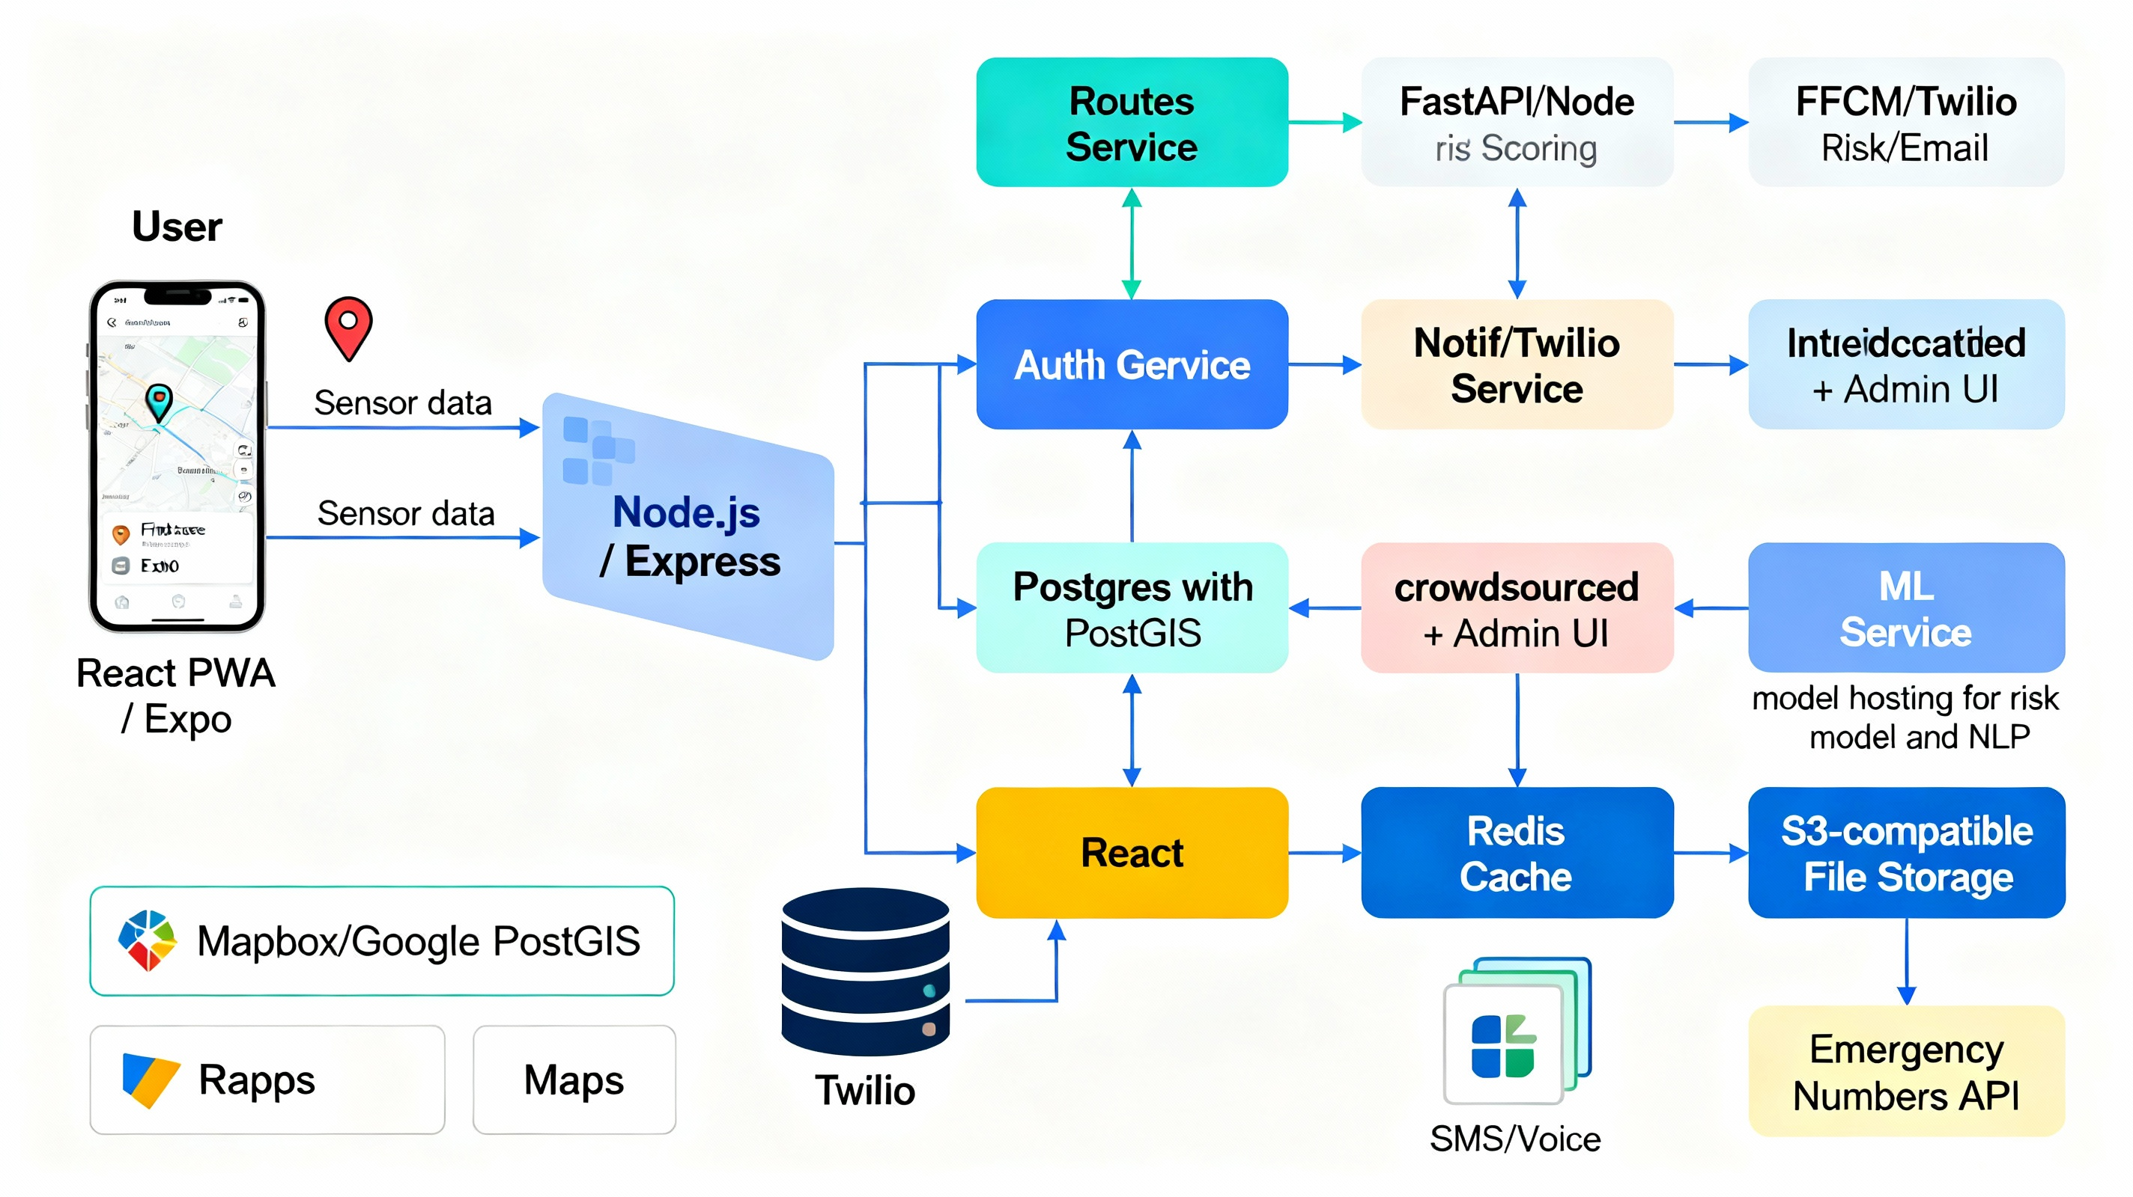
High level Architecture

Slide 4
Tech stack Selection
Frontend (User + Admin):
React (Next.js optional) for web app / PWA
Tailwind CSS for rapid styling
Zustand / Redux Toolkit for state management
Mapbox GL JS for interactive maps (or Google Maps if preferred)
React Native / Expo for mobile wrapper (optional)
Backend:
Node.js + Express (or NestJS) for API gateway
Python (FastAPI) for ML microservice / risk engine (optional: combine in Node if preferred)
PostgreSQL with PostGIS extension for spatial queries
Redis for caching
Firebase Auth or Auth0 for identity and social auth
ML / Data:
Scikit-learn / XGBoost or LightGBM for tabular risk model
Small transformer or fine-tuned DistilBERT for NLP on incident text (optional)
Geo features: heatmaps, kernel density estimation for incidents
Model serving: FastAPI + Uvicorn or TorchServe if using PyTorch

Slide 5
Data Sources & Privacy
Potential data sources:
Public crime data (city police open datasets)
OpenStreetMap for map geometry
Crowdsourced incident reports from users
Time-of-day footfall proxies (public transit APIs, population density datasets)
Privacy & Safety:
Strict opt-in for location sharing and incident reports
Pseudonymize user reports before storing
Store only necessary retention windows (e.g., 90 days) unless user opts-in
End-to-end encrypted messages sent to trusted contacts (where possible)
Provide clear safety & privacy policy on first use

Slide 6
Risk Scoring Model
Inputs (features):
Time of day, day of week
Street lighting (if available) / POI types (bars, parks)
Historical incidents count nearby (kernel density)
Distance from main roads / police stations
Population density / footfall proxy
Weather conditions (optional)
User-reported safety score
Model Type: Gradient-boosted trees (LightGBM / XGBoost) for speed and interpretability. Output: risk score [0..1].
Training label: Historical incidents aggregated into risk bins, or supervised labels from verified reports.
Serving: Precompute risk for road segments during off-peak and update incrementally from recent incidents.

Slide 7
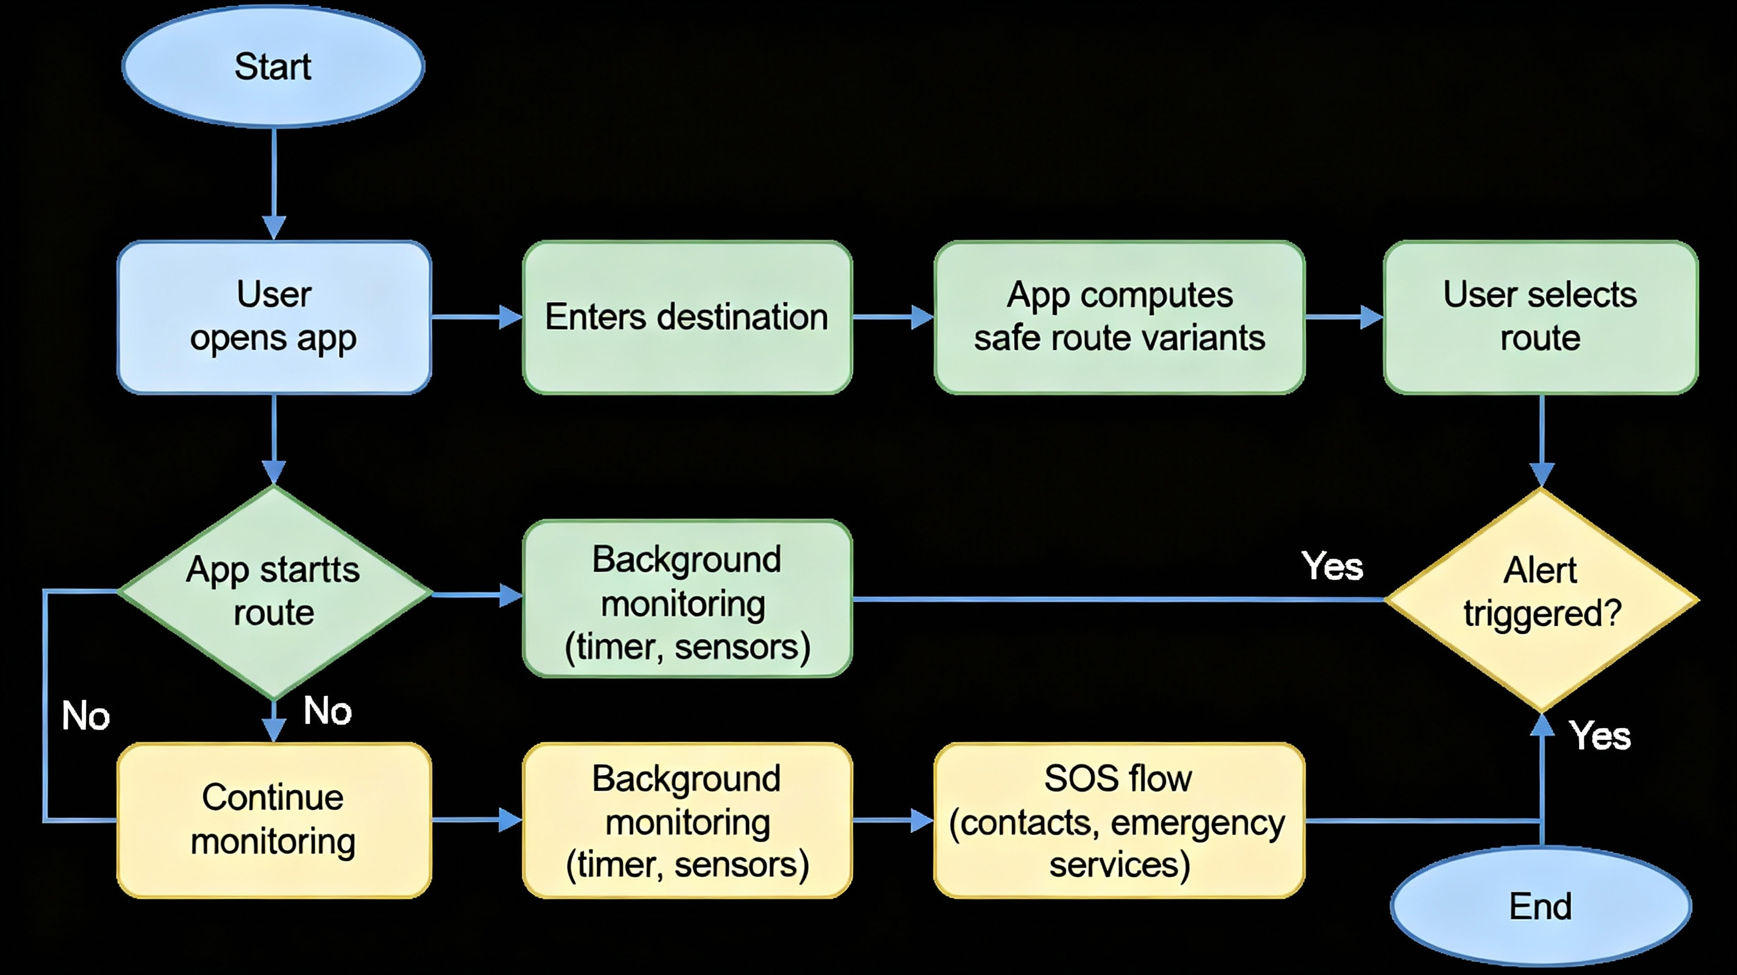
Flow Diagram

Slide 8
API Structure (REST)
Auth
POST /api/auth/signup — create account (email / phone)
POST /api/auth/login — login
POST /api/auth/otp — OTP login
User
GET /api/user/profile — user profile
PUT /api/user/profile — update profile & trusted contacts
Routing & Risk
GET /api/routes?from=lat,lng&to=lat,lng — returns multiple routes with risk scores Response: [{route_id, waypoints[], distance, duration, risk_score, segment_risks[]}]
GET /api/route/:id/segments — returns enriched segments with risk breakdown
POST /api/incidents — submit incident (lat,lng,category,description,media)
GET /api/incidents?bbox=minLon,minLat,maxLon,maxLat — fetch recent incidents
Notifications & SOS
POST /api/sos — triggers SOS; body includes location, user id, contact list, reason
POST /api/fakecall — trigger fake call to user
Admin
GET /api/admin/incidents — fetch reports for moderation
PUT /api/admin/incident/:id/verify — mark verified
ML
POST /api/ml/risk — compute risk for given segment(s) or features (used by admin & offline processing)

Slide 9
UI / UX Design
Design principles:
Minimal, low-friction: SOS is 1-2 taps maximum
High contrast, legible typography, big tappable controls
Dark-mode and stealth mode (discreet UI for safety)
Map-first interface: show current location, safe/unsafe heatmap overlay
Key screens:
Onboarding & Permissions — explain why permissions needed; quick setup of trusted contacts
Home / Map View — search bar, 'Where to?', quick SOS button, nearby safety alerts
Route Options — cards for 'Safest' vs 'Fastest' vs 'Balanced' with color-coded risk
Navigation Screen — turn-by-turn; small panic button; timer/check-in widget
SOS Flow — confirm screen with countdown (discreet option), auto-send location + audio recording (optional)
Report Incident — quick form + optional photo
Profile / Trusted Contacts — manage contacts & emergency numbers
Admin Dashboard — moderation queue, heatmaps, incident analytics
Micro-interactions:
Haptic feedback on SOS trigger (if native)
Subtle pulsing on the safest route card
Smooth map transitions and informative tooltips

